Slide 1
Application of Stacks
Recursion

Slide 2
Tower of Hanoi
The Tower of Hanoi is a mathematical game or puzzle. It consists of three rods, and a number of disks of different sizes which can slide onto any rod. The puzzle starts with the disks in a neat stack in ascending order of size on one rod, the smallest at the top, thus making a conical shape.
The objective of the puzzle is to move the entire stack to another rod, obeying the following simple rules:
Only one disk can be moved at a time.
Each move consists of taking the upper disk from one of the stacks and placing it on top of another stack i.e. a disk can only be moved if it is the uppermost disk on a stack.
No disk may be placed on top of a smaller disk.

Slide 3
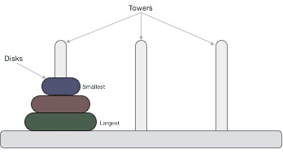

Slide 4
In other words,
For N = 3, we shall have the following moves
A C
A B
C B
A C
B A
B C
A C

Slide 5
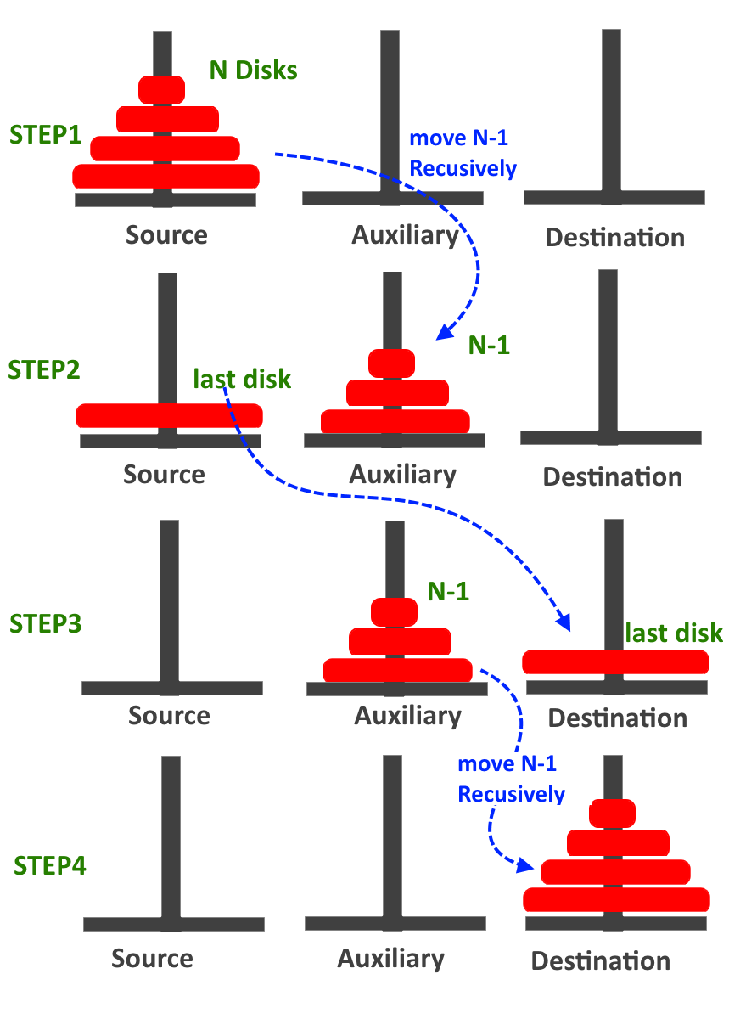

Slide 6
Let us now introduce the general notation
TOWER(N, BEG, AUX, END)
Denote a procedure which moves the top n disks from the initial peg BEG to the final peg END using the peg AUX as an auxiliary.
When n = 1, we have the following obvious solution:
TOWER(1, BEG, AUX, END)
consists of the single instruction BEG END
Furthermore, when n > 1, the solution may be reduced to the solution of the following 3 subproblems:
TOWER(N-1, BEG, END, AUX)
TOWER(1, BEG, AUX, END) or BEG END
TOWER(N-1, AUX, BEG, END)

Slide 7
TOWER(N, BEG, AUX, END)
This procedure gives a recursive solution to the Towers of Hanoi problem for N disks.
If N = 1, then:
  (a) Write BEG END.
  (b) Return.
2. Call TOWER(N-1, BEG, END, AUX).
3. Write BEG END.
4. Call TOWER(N-1, AUX, BEG, END).
5. Return.

Slide 8
Non-Recursive (Iterative) Solution for Tower of Hanoi
Calculate the total number of moves required i.e. “2^{n} - 1" here ‘n’ is number of disks.
If number of disks (i.e. n) is even then interchange destination pole and auxiliary pole.
for i = 1 to total number of moves:
if i%3 == 1:
legal movement of top disk between source pole and destination pole
if i%3 == 2:
legal movement top disk between source pole and auxiliary pole
if i%3 == 0:
legal movement top disk between auxiliary pole and destination pole

Slide 9


Let us understand with a simple example with 3 disks:
So, total number of moves required = 7
S A D
When i= 1, (i % 3 == 1) legal movement between‘S’ and ‘D’

Slide 10


When i = 2, (i % 3 == 2) legal movement between ‘S’ and ‘A’
When i = 3, (i % 3 == 0) legal movement between ‘A’ and ‘D’

Slide 11


When i = 4, (i % 3 == 1) legal movement between ‘S’ and ‘D’
When i = 5, (i % 3 == 2) legal movement between ‘S’ and ‘A’

Slide 12


When i = 6, (i % 3 == 0) legal movement between ‘A’ and ‘D’
When i = 7, (i % 3 == 1) legal movement between ‘S’ and ‘D’

Slide 13
Try to implement the program of Iterative TOH !!

